Slide 1
AIRCRAFT PRODUCTION TECNOLOGY STUDY CASE 1 (LAB work 1)
Victor Gurov

Slide 2
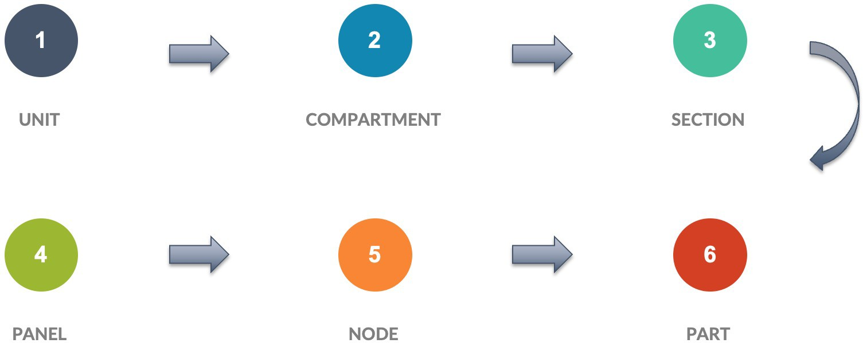
AIRCRAFT PARTS – CONSTRACTION SEPARATION

Slide 3
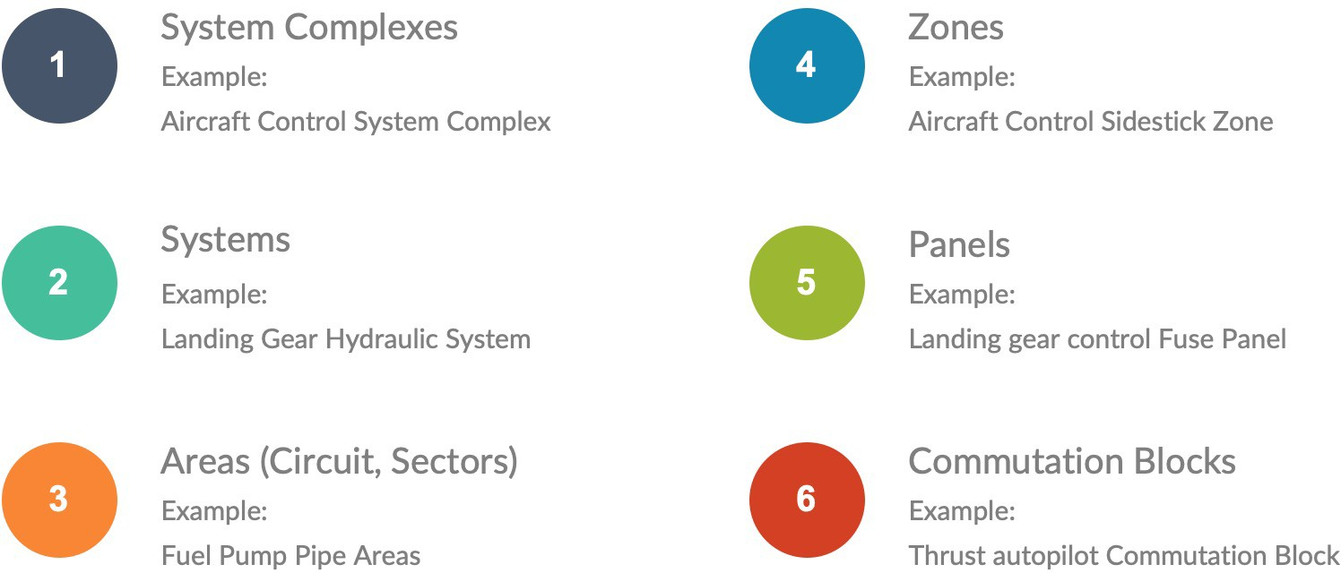
AIRCRAFT PARTS – Onboard system separation

Slide 4
Study case assignment
Part is a product made of a homogeneous material without the use of assembly operations.

Slide 5
Study case assignment
1. Pick one aircraft part and (!!!) one electronic part/ (preferably those parts you know something about or design\work with it before.
2. Locate this part in the other more common sections of the aircraft construction. (need at least one graphic explanation of localization)
3. On each level (from part and up to the system complex/unit) provide following information:
Part location explanation (additional graphical explanation will be preferable)
Interconnected part list (if it is a brake lining you need to enlist brake shoe, brake pad, wheel cylinder, disk rotor and etc.)
Define the main purpose of the describe level (what does this part/ node/ section/ zone/ area performs in the whole aircraft)

Slide 6
Study case acceptance criteria
You need to list all 6 levels of construction separation in the greatest level of details you can. (if some level is missing, you need to explain why);
More graphic content;
Information completeness;
Check carefully about separation misspelling (make sure where is section and where is a compartment and so on).

